Slide 1

Voice Of Kerala
Submitted By: Akhila Mohanan Project Guide: Anu V Jacob
Course: MCA S6

Slide 2
contents
Abstract
Modules
Technology hierarchy
System specification
Table Design
UML
Forms

Slide 3
ABSTRACT
Voice of Kerala is the one of the integrated radio channel broadcasting exclusive programmes for all GCC countries.It is a mobile application work in android platform.It is a malayalam radio broadcasting started from Gulf region.The initiative continues to 24 hours live now as a voice of kerala 1152AM with more interesting contents.It can provide various services such as listen live FM channel ,Message RJ,Podcast information ,day to night programme schedule,instant news updates,Videos and images are potsed in instagram..

Slide 4
Module description
Mobile application ( android & IOS application)
Web portal
Mobile application ( android & IOS application
LISTEN LIVE
MESSAGE RJ
POD CAST
PROGRAMME SCHEDULE
NEWS
RATE US
ABOUT US
VIDEOS
IMAGES

Slide 5
Listen Live
We can listen the FM channel in live .
Containing a list of Stations.
we can record the songs and it save in gallery.
Message RJ
The user /visitor can message to the RJ by just entering their name,country ,mobile and email id.
After entering this details the user can register and they can select the RJ name and send message .

Slide 6
Podcast
Shows the list of music available on the FM channel and we can listen the music.
Programme Schedule
It is the day to night programme schedule of all stations and we can choose the station.
News
Display different category of news such as
general,politics,entertainment,sports,localnewsn,business,health,
environment,technical etc.
The user can share the news to varies social media pages.

Slide 7
Rate Us
User can rate the application from play store.
About Us
Videos
It is a link for watch the important videos from different category.we can
watch the videos From youtube and download the videos.
Images
It shows the images posted in instagram.
We can share the videos through social media .

Slide 8
Web Portal
News update
Add/delete podcast Details
Update /Delete Programme Schedules
Add new RJ’s and chart their programme Lists
Update Images
update /delete Videos

Slide 9
Technology hierarchy
MOBILE APPLICATION – HYBRID
Cordova Ionic
Angular JS version .1
WEBPORTAL – RESPONSIVE
HTML
CSS
JQuery
Twitter Bootstrap
BACKEND
WODRPRESS
PHP
MySQL

Slide 10
Introduction to PHP
PHP is a server-side scripting language designed for web development but also used as a general-purpose programming language. PHP code is usually processed by a PHP interpreter, which is usually implemented as a web server's native module or a Common Gateway Interface (CGI) executable. After the PHP code is interpreted and executed, the web server sends resulting output to its client, usually in form of a part of the generated webpage; for example, PHP code can generate a web page's HTML code, an image, or some other data. PHP has also evolved to include a command-line interface (CLI) capability and can be used in standalone graphical applications.

Slide 11
My SQL
Structured Query Language (SQL), in computer science, a database sub language used in querying, updating and managing relational databases. MY SQL Server is a relational database management system for distributed Client-Server computing. Like all other database management systems, it provides the following features:
A variety of user interfaces
Physical data independence
Logical data independence
Query optimization
Data integrity
Concurrency control
Backup and recovery
Security and authorization

Slide 12
Android
Android is a mobile operating system developed by Google, based on the Linux kernel and designed primarily for touch screen mobile devices such as smart phones and tablets. Android's user interface is mainly based on direct manipulation, using touch gestures that loosely correspond to real-world actions, such as swiping, tapping and pinching, to manipulate on-screen objects, along with a virtual keyboard for text input.

Slide 13
NETBEANS
Netbeans is an integrated development environment (IDE) for developing primarily with Java, but also with other languages, in particular PHP, C/C++, and HTML5.It is also an application platform framework for Java desktop applications and others. The NetBeans IDE is written in Java and can run on Windows, OS X, Linux, Solaris and other platforms supporting a compatible JVM. The Net Beans Platform allows applications to be developed from a set of modular software components called modules
Among the features of the platform are:
User interface management (e.g. menus and toolbars)
User settings management
Storage management (saving and loading any kind of data)
Window management

Slide 14
IONIC FRAMEWORK
Ionic is a powerful HTML5 SDK that helps you build native-feeling mobile apps using web technologies like HTML, CSS, and JavaScript.Ionic is focused mainly on the look and feel, and UI interaction of your app. That means we aren't a replacement for PhoneGap or your favourite JavaScript framework. Instead, Ionic simply fits in well with these projects in order to simplify one big part of your app: the front end. We recommend reading, Where does the Ionic Framework fit in? to get a good understanding of Ionic's goals.

Slide 15
WORDPRESS
WordPress is an open source Content Management System (CMS), which allows the users to build dynamic websites and blogs. WordPress is the most popular blogging system on the web and allows updating, customizing and managing the website from its back-end CMS and components.
WordPress is an Content Management System (CMS), which is open source and was created to manage blogs. WordPress allows you to easily create and manage your blogs and websites content without coding and it can be used to create fully operational website. It is a software which stores all the data such as text, photos, music, documents, etc. and is made available on your website. It helps in editing, publishing and modifying the content of the website.
WordPress was initially released on 27th May, 2003 by Matt Mullenweg and Mike Little.It was announced as open source in October 2009.
Wordpress Features
We can create dynamic website without any programming and designing knowledge.
User Management
Media Management
Theme System
Extended With Plugins
Search Engine Optimization
Importers

Slide 16
GITHUB
Version control is a system that manages changes to a file or files.
These changes are kept as logs in a history, with detailed information on what file(s) was changed, what was changed within the file, who changed it, and a message on why the change was made.
This is extremely useful, especially when working in teams

Slide 17
BUGZILA
Bugzilla is an open-source issue/bug tracking system that allows developers effectively to keep track of outstanding problems with their product. It is written in Perl and uses MYSQL database.
Bugzilla is a Defect tracking tool, however it can be used as a test management tool as such it can be easily linked with other Test Case management tools like Quality Center, Testlink etc.
This open bug-tracker enables users to stay connected with their clients or employees, to communicate about problems effectively throughout the data-management chain.

Slide 18
System specification
Hardware specification
Processors : Intel Premium Pro or Processor running at 133 MHz
Hard Disk : 1.2 GB Hard Disk
RAM : Client Level – Minimum 128MB
Recommended Requirements for peak performance
RAM : Client Level – Minimum 512MB
Display Type : SVGA Colour Enhanced Monitor
Mouse : PS/2 2 Button

Slide 19
Software specification
Front End Tool : HTML, JavaScript, CSS, Twitter Bootstrap, Android, Ionic
Back End Tool : PHP, MySQL,Wordpress
Development Tools : Net Beans
Operating System : Windows 8.1
Browse : Google Chrome. Mozilla Firefox

Slide 20
Table design
1.Tbl_Station
primary key:Id
FIELD | TYPE | DESCRIPTION
Id | bigint(10) | Primary key
Station_name | Varchar(50) | Station name

Slide 21
2.Tbl_RJ
Primary key:RJ_id
FIELD | TYPE | DESCRIPTION
RJ_Id | bigint(10) | Primary key
Station_id | bigint | Foreign key
Programme _Name | Varchar(50) | Programme name
emailid | Varchar(50) | Email id of RJ

Slide 22
3.Tbl_UserRegister
primary key:Reg_id
FIELD | TYPE | DESCRIPTION
Reg_id | bigint(10) | Primary key
Name | Varchar(50) | Username
Country | Varchar(50) | Country Name
Mobile | int(12) | Mobile no
Email Id | Varchar(50) | Email id
Register | Varchar(50) | Register

Slide 23
4.Tbl_Message RJ
Primary key:Message_id
FIELD | TYPE | DESCRIPTION
Message_Id | bigint(10) | Primary key
Station_id | bigint | Foreign key
Choose _station | Varchar(50) | Station name
Choose_ RJ | Varchar(50) | RJ name
Send _message | longtext | Content of the message

Slide 24
5.Tbl_programme Schedule
Primary key:Progamme_id
FIELD | TYPE | DESCRIPTION
Programme_Id | bigint(10) | Primary key
Station_id | bigint | Foreign key
RJ_name | Varchar(50) | RJ name
Time | datetime | Time for the Programme
Station_name | varchar(50) | Station name
Image | varchar(100) | Image of the programme

Slide 25
5.Tbl_podcast
Primary key:Podcast_id
FIELD | TYPE | DESCRIPTION
Podcast_Id | bigint(10) | Primary key
Programme_name | Varchar(50) | Name Of the Programme
Upload_audio | Varchar(50) | Audio of the song
RJ_name | Varchar(50) | Name of the RJ
Time | datetime | Time for the programme
Image | varchar(100) | Image of the programme

Slide 26
6.Tbl_News
Primary key:News_id
FIELD | TYPE | DESCRIPTION
News_Id | bigint(10) | Primary key
Title | Varchar(50) | Title of News
Date | datetime | Date for post news
Time | datetime | Time for post News
Content | longtext | Content of the news
Image | Varchar(50) | Image of the news
Status | Varchar(50) | Status of the post

Slide 27
7.Tbl_photos
Primary key:Photo_id
FIELD | TYPE | DESCRIPTION
Photo_Id | bigint(10) | Primary key
Title | Varchar(50) | Title of image
Image | Varchar(50) | Images posted In instagram

Slide 28
8.Tbl_videos
Primary key:video_id
FIELD | TYPE | DESCRIPTION
video_Id | bigint(10) | Primary key
Title | Varchar(50) | Title of image
Youtube_link | Varchar(50) | Link for youtube
Image | Varchar(50) | Images of the video

Slide 29
8.Tbl_advertisment
Primary key:advertisment_id
FIELD | TYPE | DESCRIPTION
advertisment_Id | bigint(10) | Primary key
programme_id | bigint | Foreign key
Title | Varchar(50) | Title of the advertisment
Programme_image | Varchar(50) | Image of the programme
Advertisment_image | Varchar(50) | Image for advertisment

Slide 30
9.Tbl_events
Primary key:Event_id
FIELD | TYPE | DESCRIPTION
Event_Id | bigint(10) | Primary key
programme_id | bigint | Foreign key
Title | Varchar(50) | Title of the Programme
Add_media | Varchar(50) | images/audios for the event
content | longtext | Description of the event
Event_venue | Varchar(100) | Place of the event
Event_date | datetime | Date of the event
Event_time | datetime | Time for the Event
Ticket_url | Varchar(100) | Link for book ticket
Text_button | Varchar(100) | To know the status of the ticket
image | Varchar(100) | Images for the event

Slide 31
TABLES FOR PUSH DATA
10.Tbl_gcmtockens
Primary key:Id
FIELD | TYPE | DESCRIPTION
Id | bigint(10) | Primary key
Device_tocken | Varchar(50) | Tocken name
Old_tocken | Varchar(50) | Old tocken name
Data | text | data

Slide 32
12.Tbl_postmeta
Primary key:Meta _id
FIELD | TYPE | DESCRIPTION
Meta_Id | bigint(10) | Primary key
Post_id | Bigint(20) | foreignkey
Meta_key | Varchar(255) | Metakey Value
Meta_value | longtext | Value for metadata

Slide 33
11.Tbl_option
Primary key:Option _id
FIELD | TYPE | DESCRIPTION
Option_Id | bigint(10) | Primary key
Option_name | Varchar(50) | Option name
Option_value | longtext | Values of option
Auto_load | longtext | Auto load information

Slide 34
13.Tbl_post
Primary key:post_id
FIELD | TYPE | DESCRIPTION
Post_Id | bigint(10) | Primary key
Post_author | Varchar(50) | Post the author name
Post_date | datetime | Date of the post
Post_content | longtext | Content of the post
Post_excerpt | text | Post excerpt
Post_status | Varchar(20) | Staus of the post
Comment_status | Varchar(20) | Comments for the posted status
Post_passward | Varchar(55) | Passward of the post
Post_name | Varchar(20) | Name of the person who post
Post_modified | datetime | Modify post

Slide 35
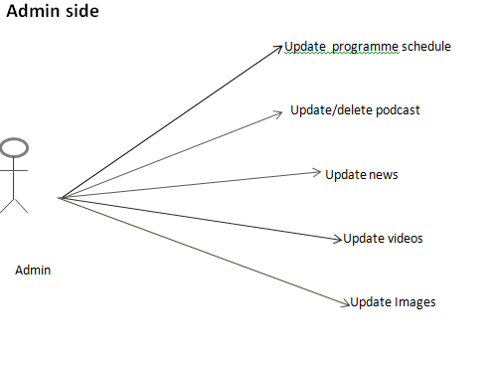
UML

Slide 36
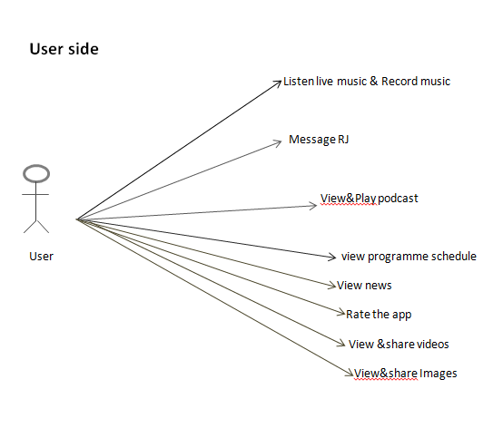

Slide 37
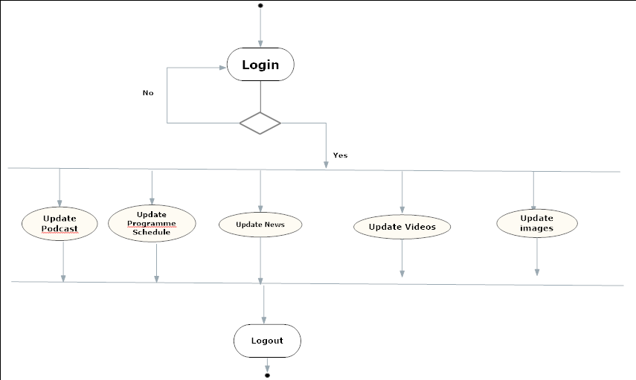
Activity diagram
ADMIN-SIDE

Slide 38
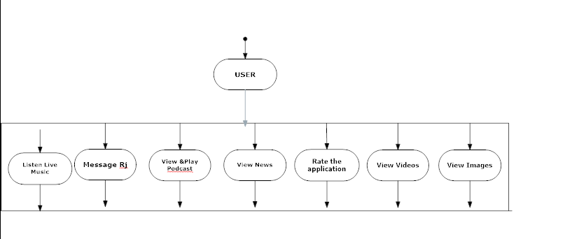
USER-SIDE

Slide 39
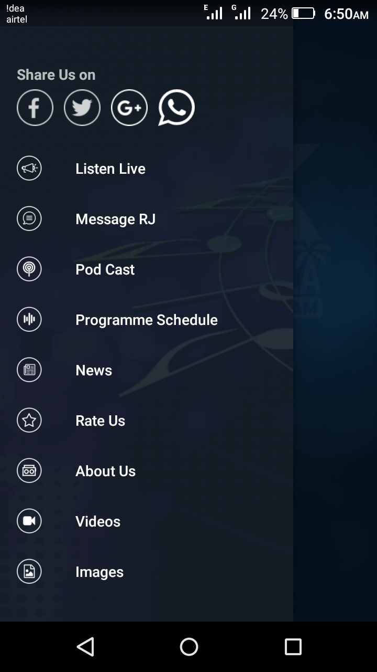
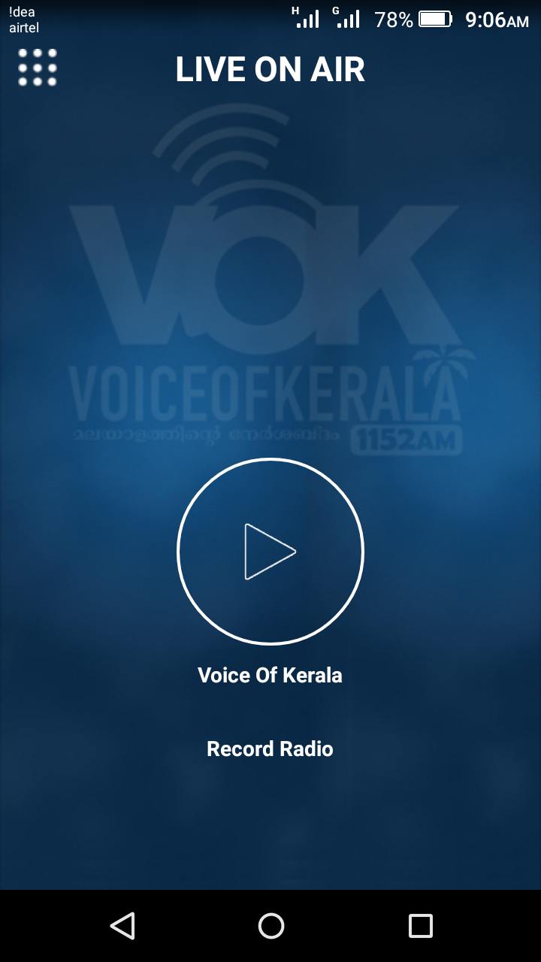
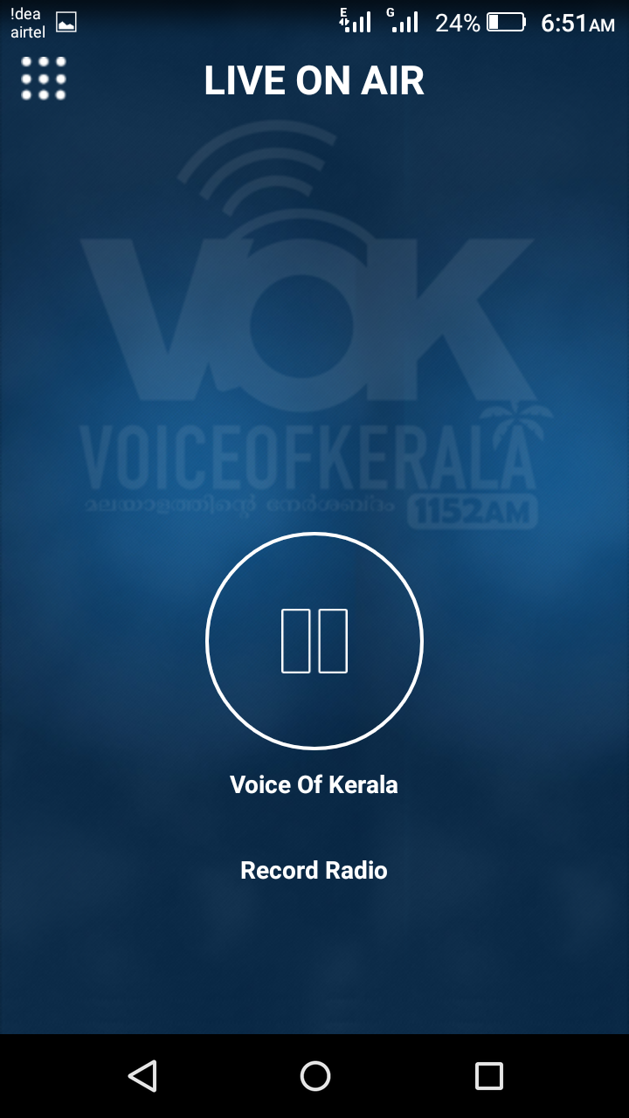
Form
LIVE ON AIR

Slide 40
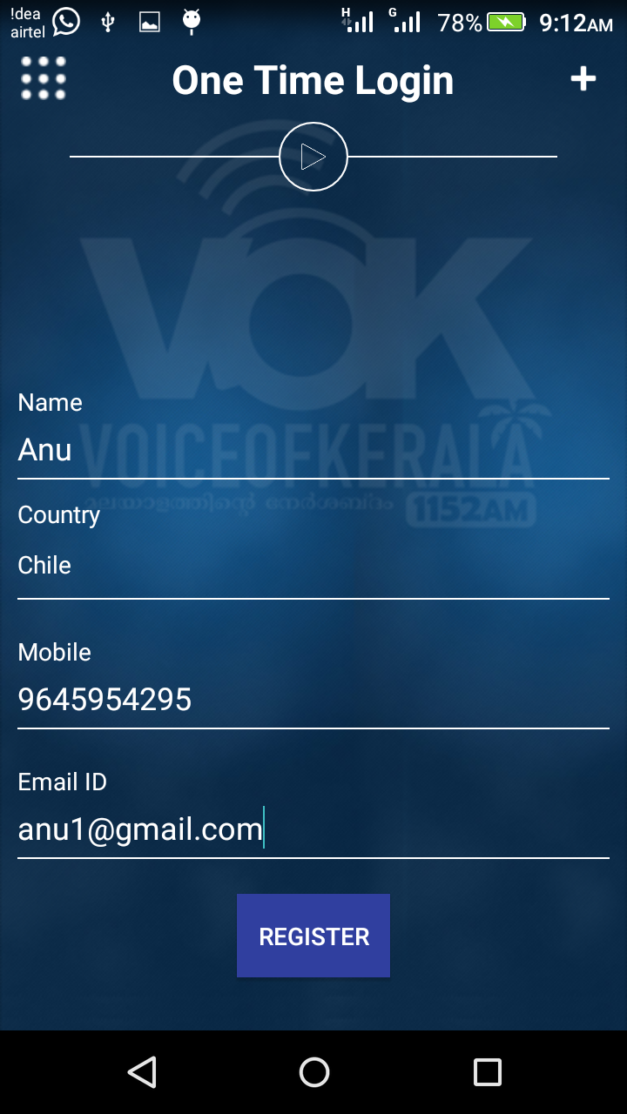
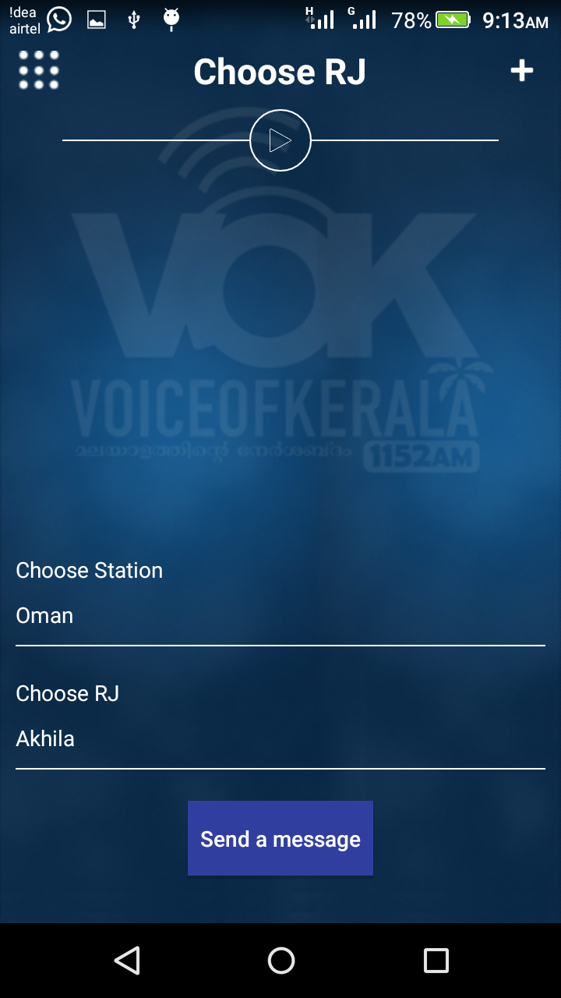
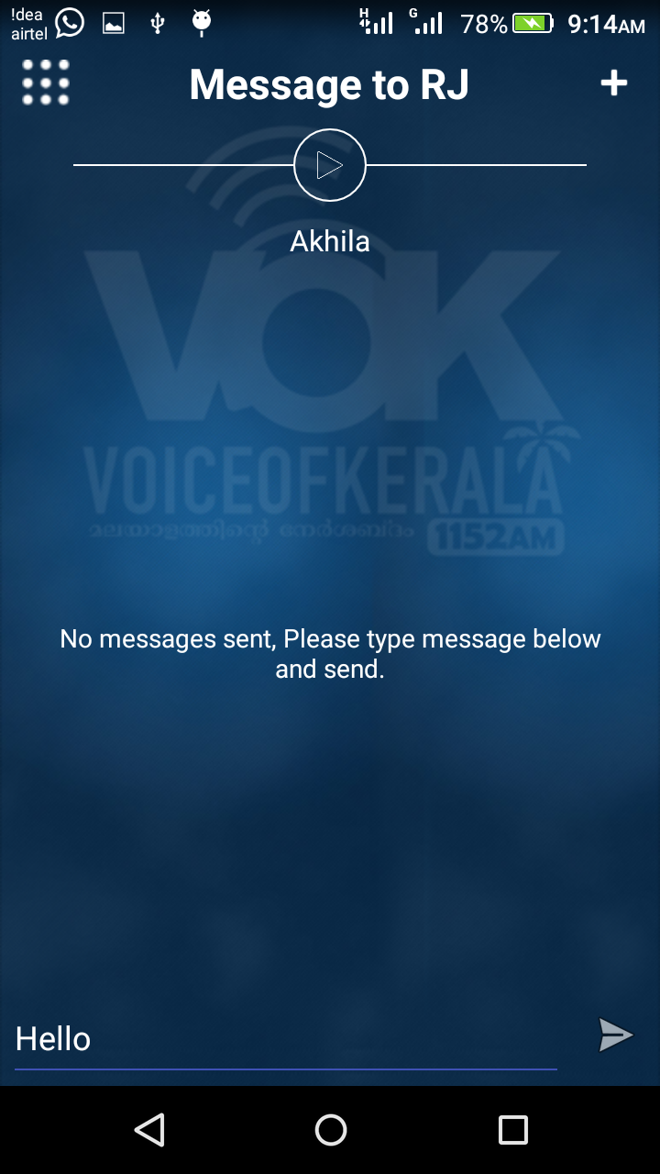
MEESSAGE RJ

Slide 41
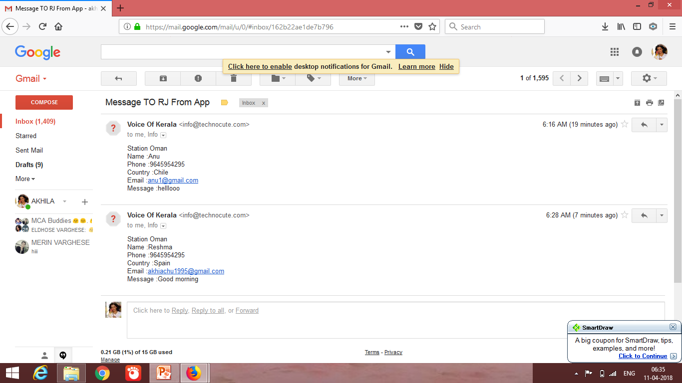
PODCAST

Slide 42
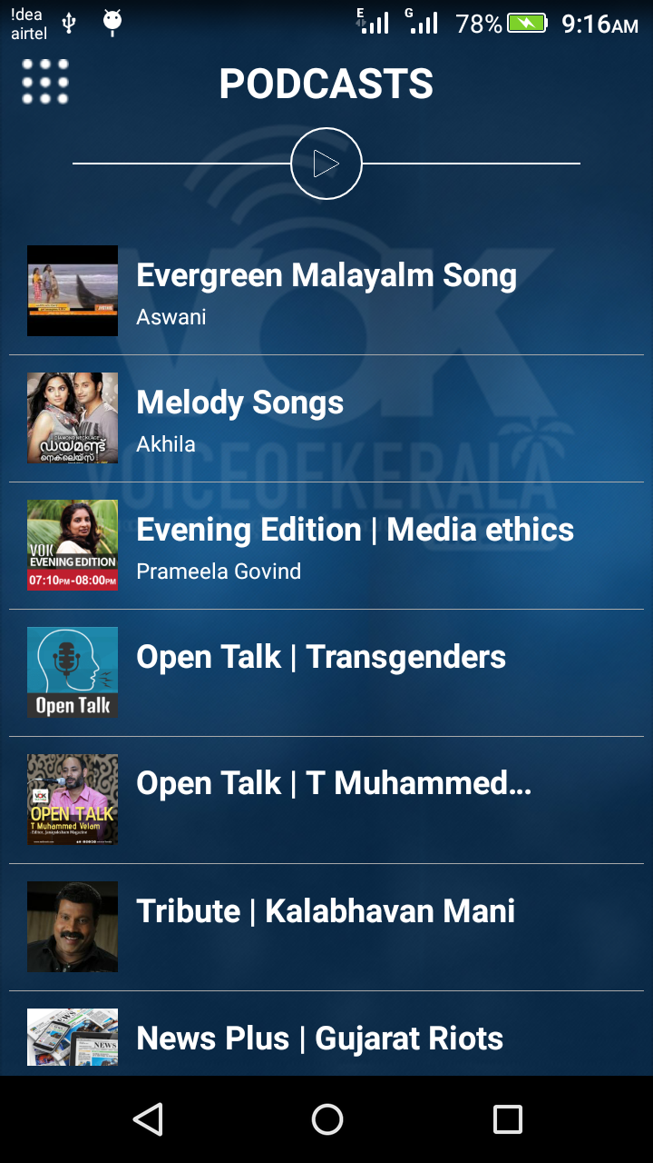
PODCAST

Slide 43
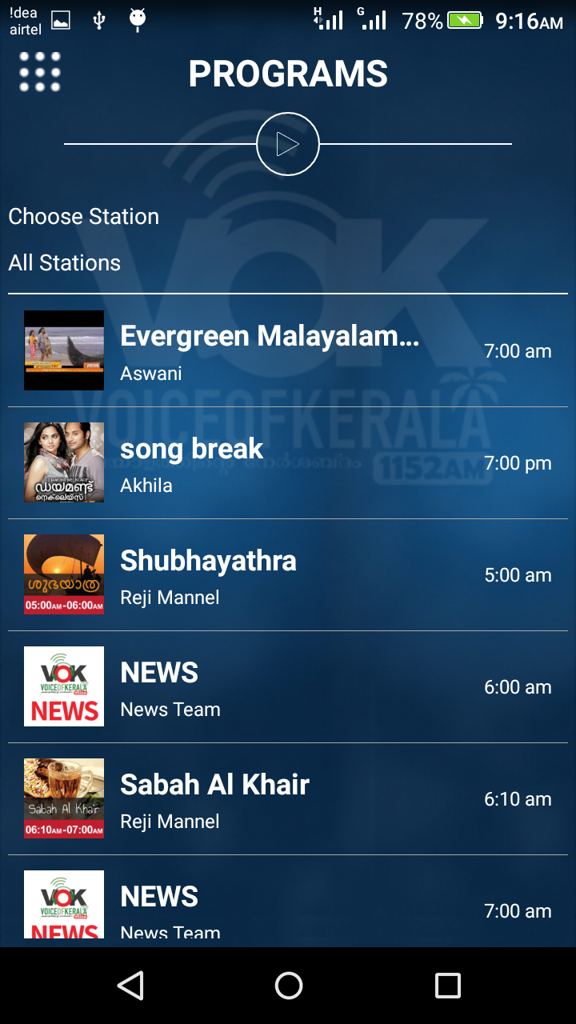
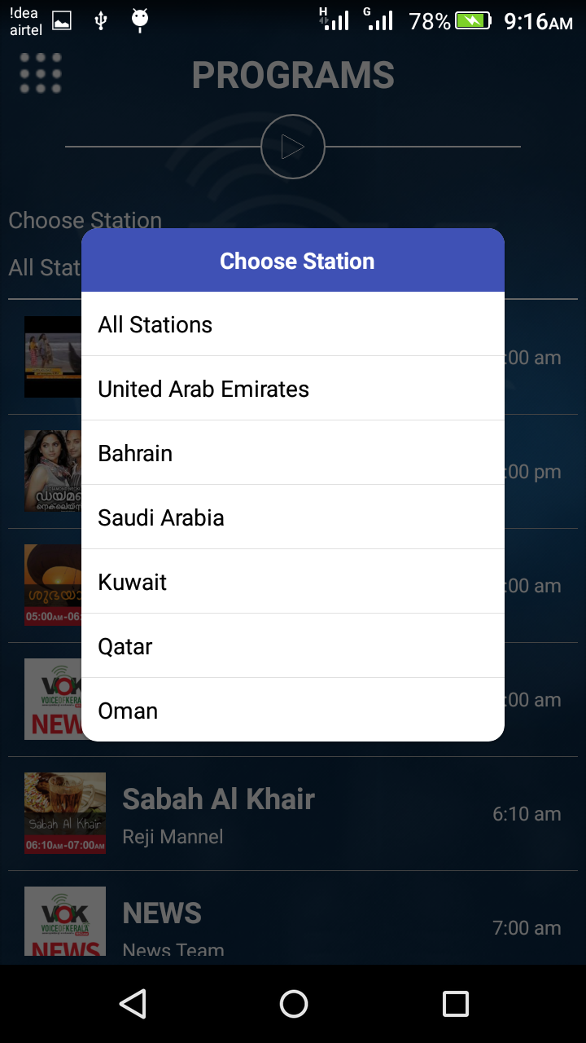
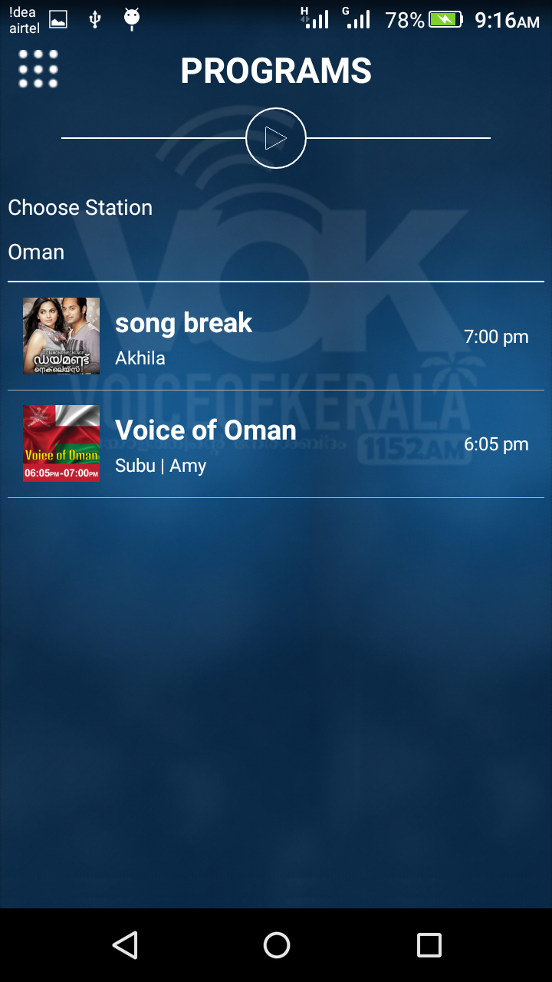
PROGRAMME SCHEDULE

Slide 44
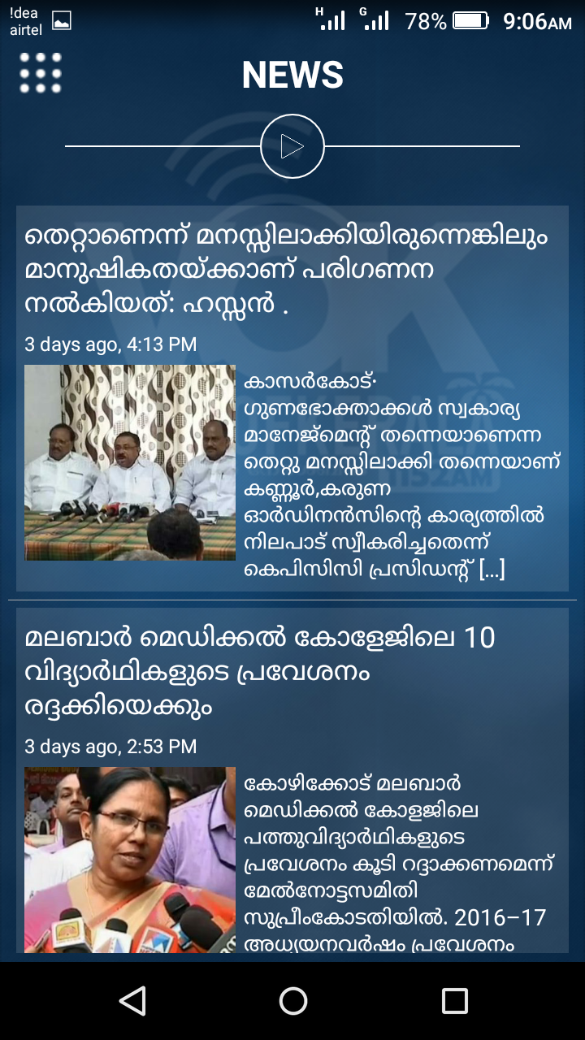
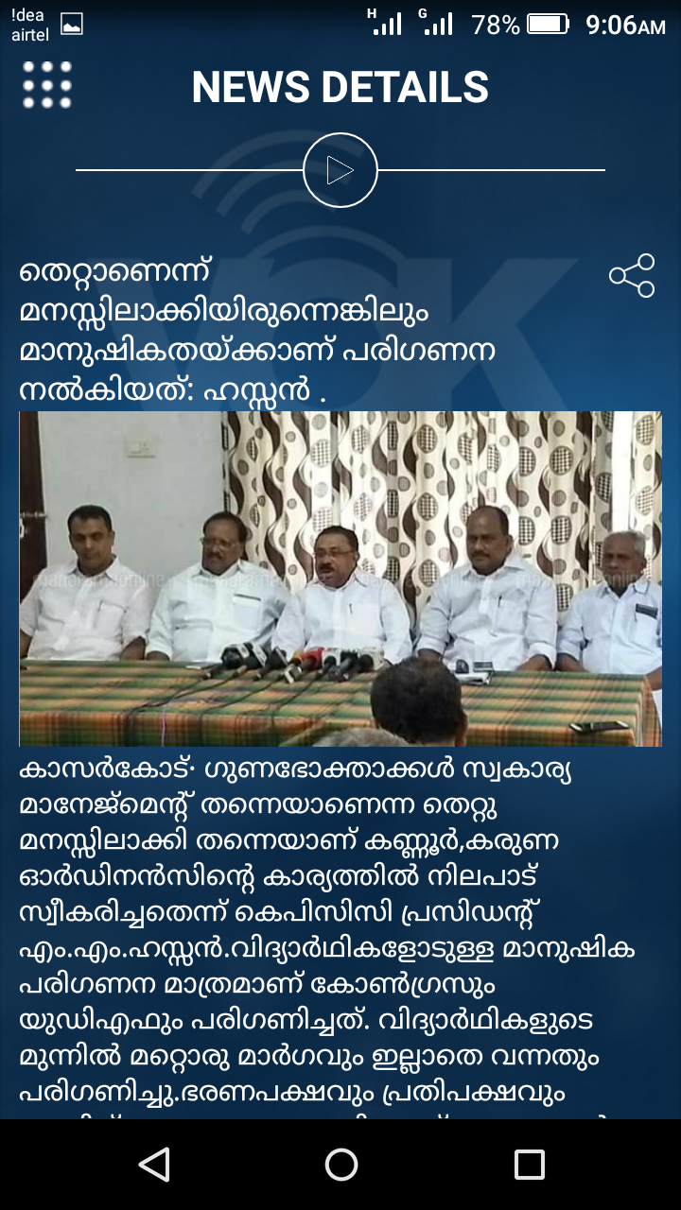
NEWS

Slide 45
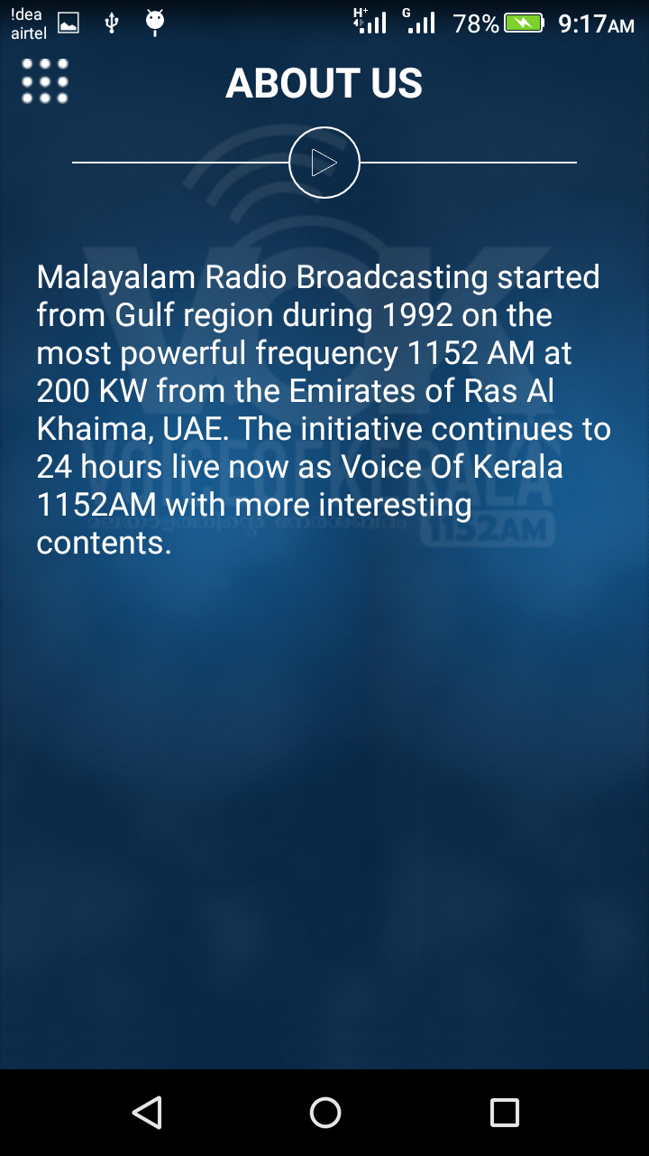
ABOUT US

Slide 46
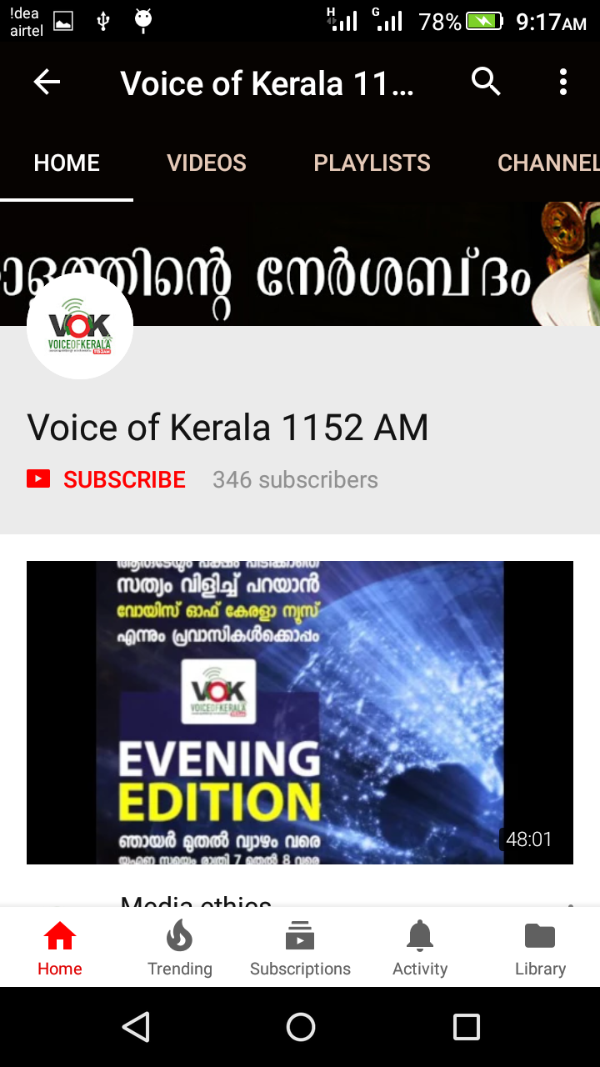
VIDEOS

Slide 47
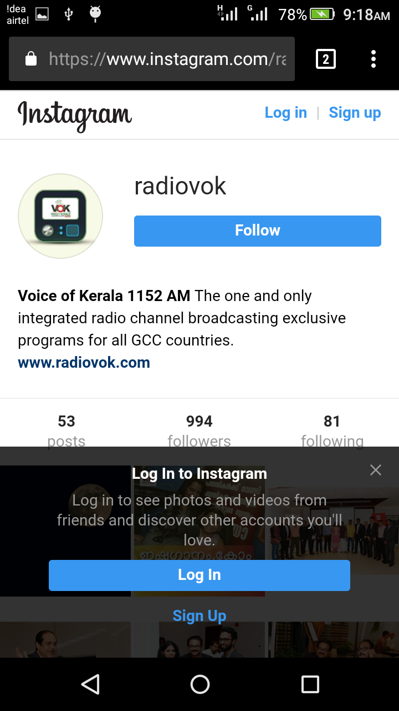
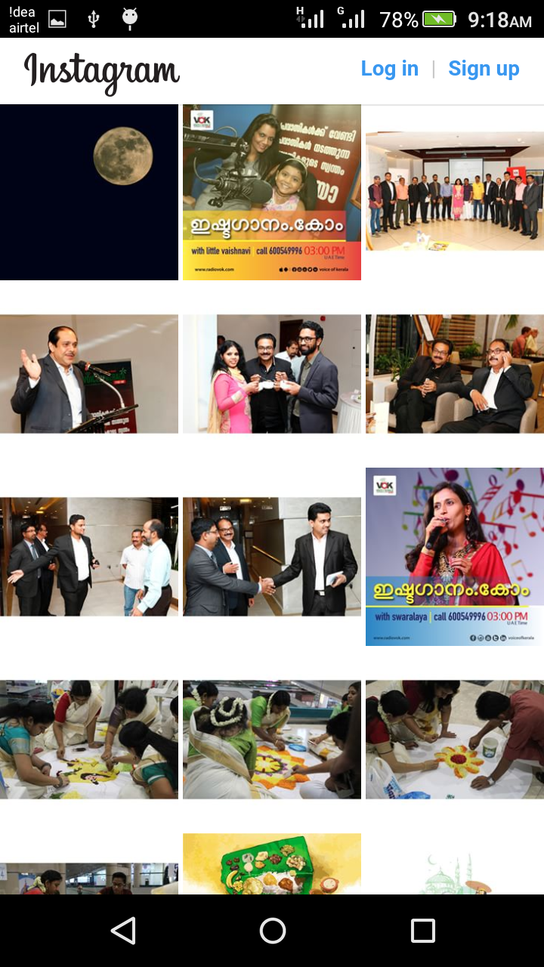
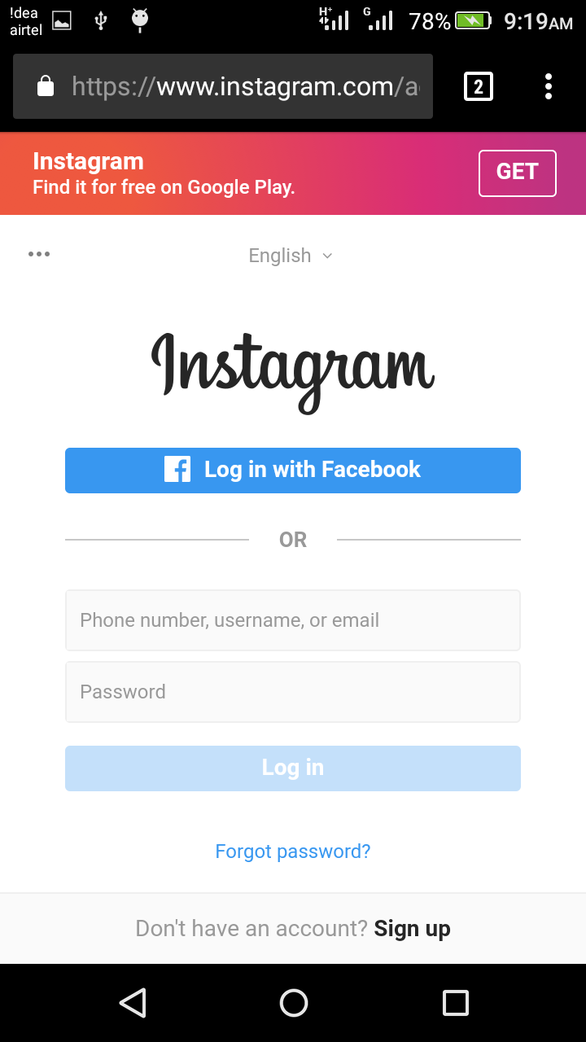
IMAGES

Slide 48
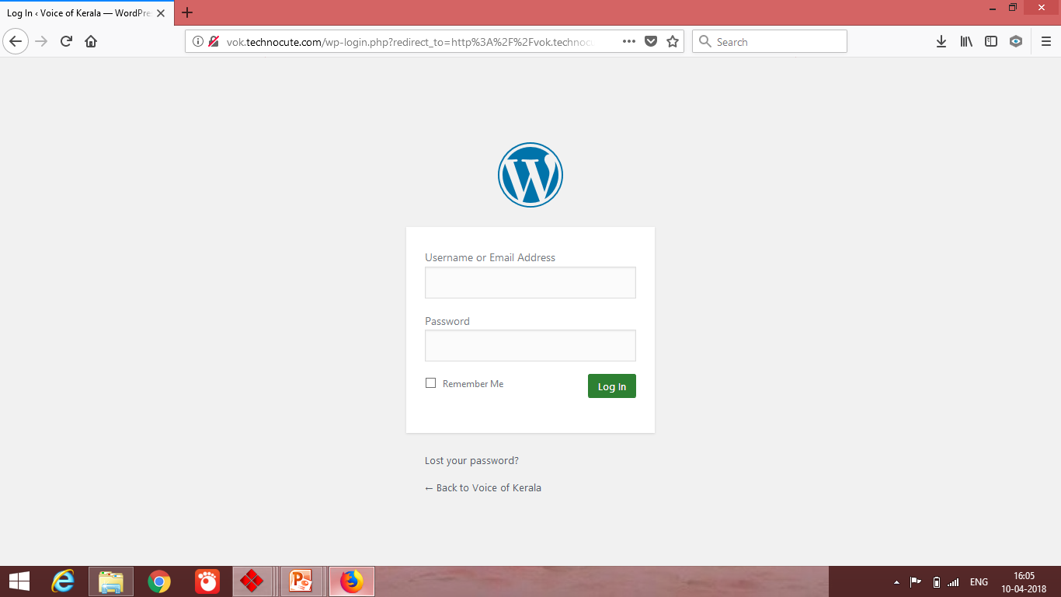
WEB PORTAL

Slide 49
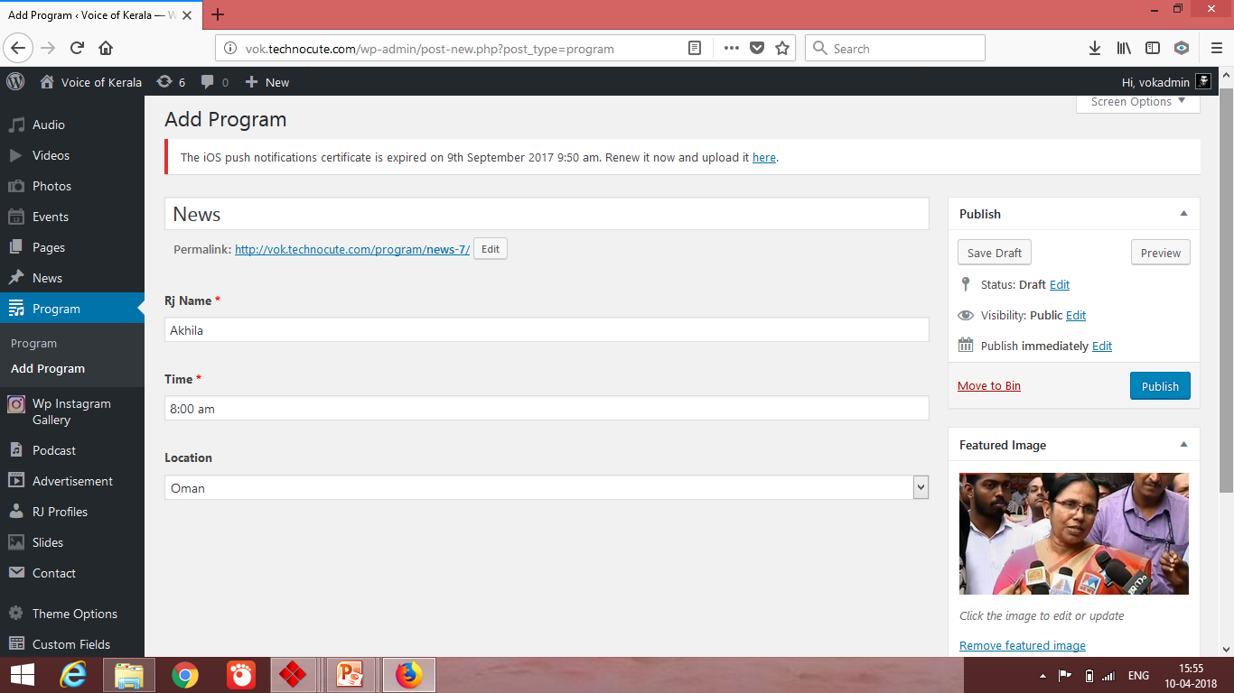
ADD PROGRAMES

Slide 50
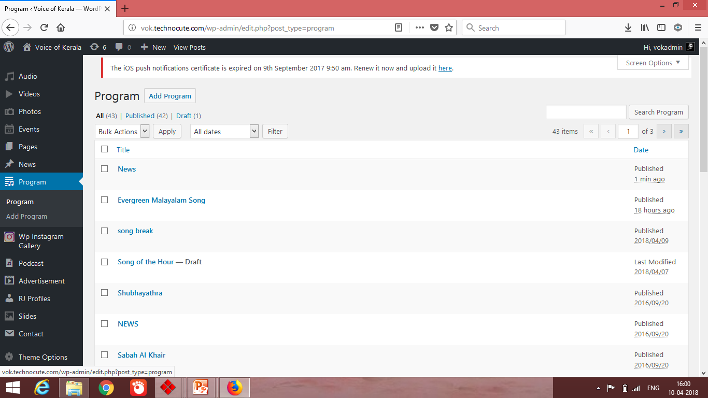
PROGRAME SCHEDULED

Slide 51
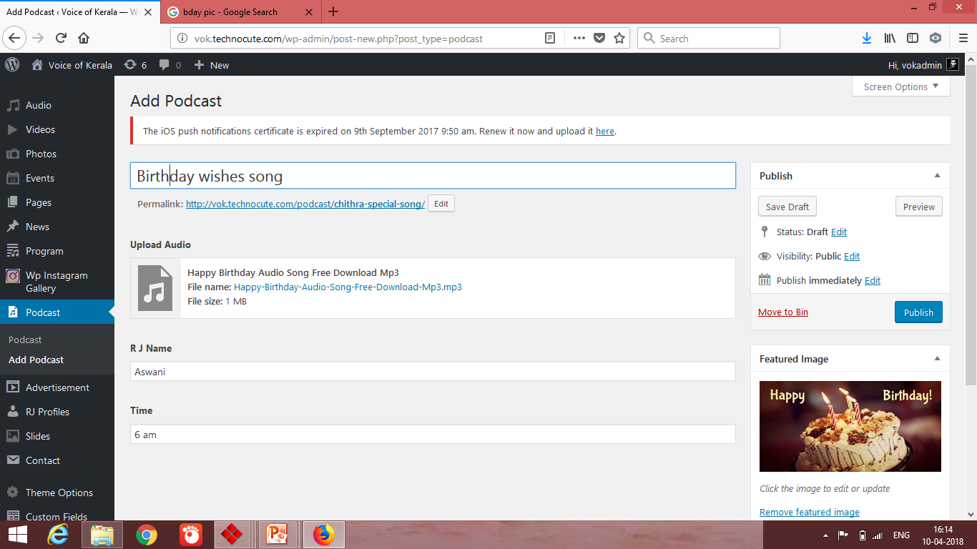
ADD PODCAST

Slide 52
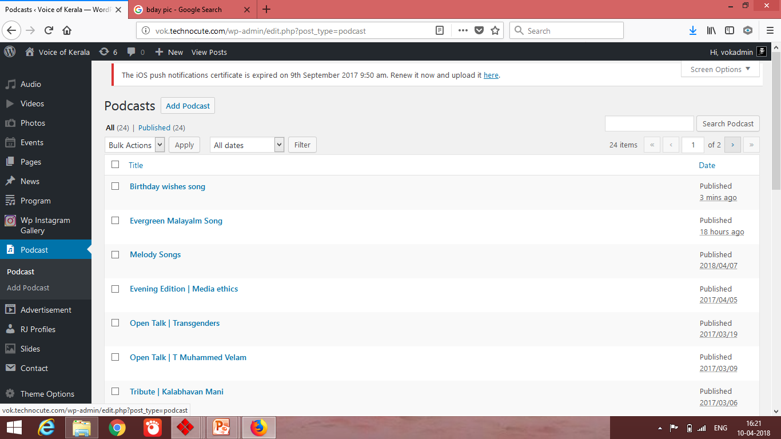
PODCAST UPDATED

Slide 53
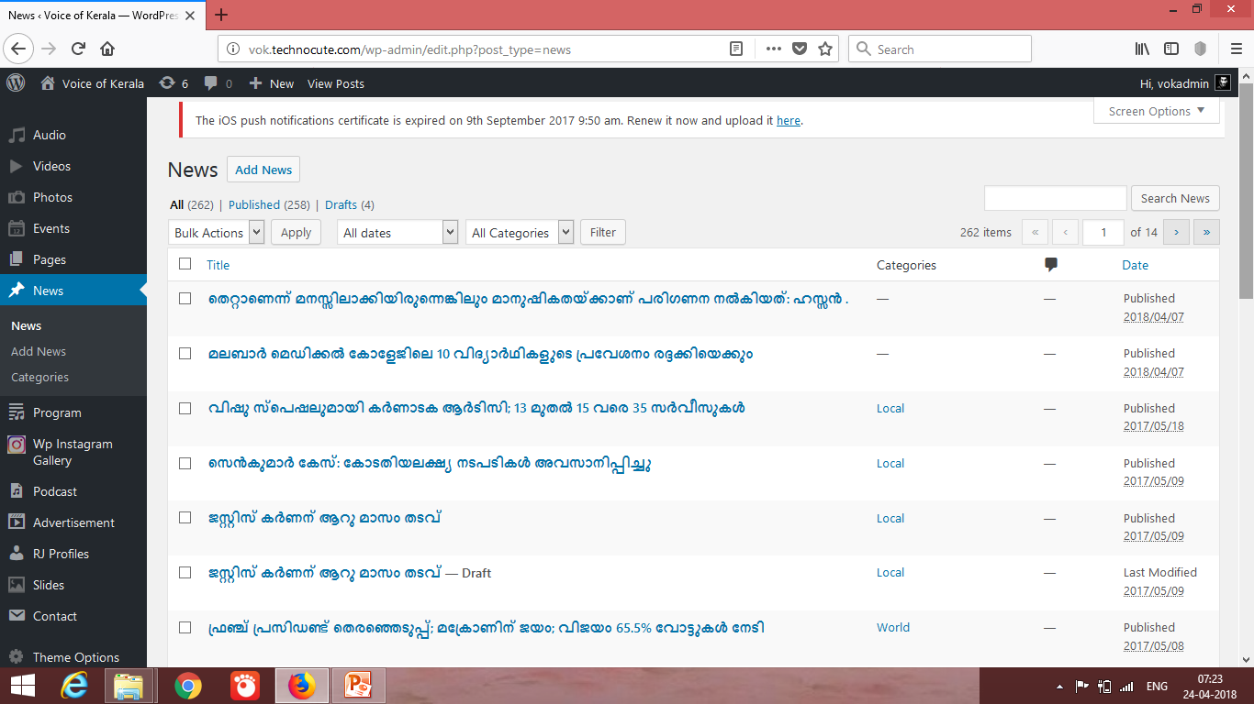
NEWS UPDATED

Slide 54
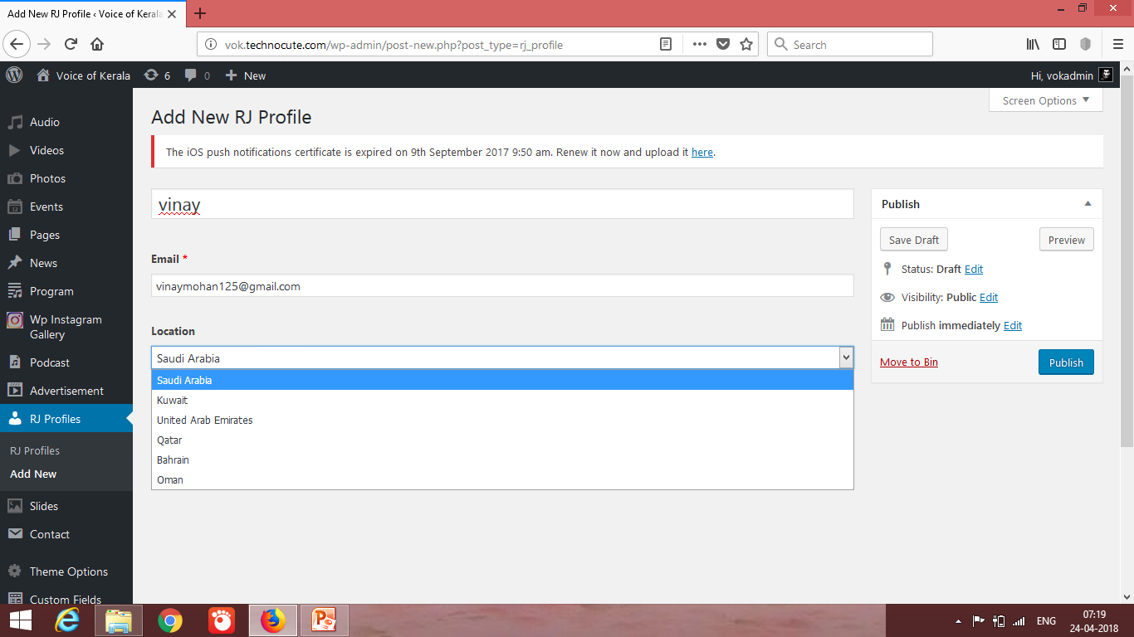
ADD NEW RJ

Slide 55
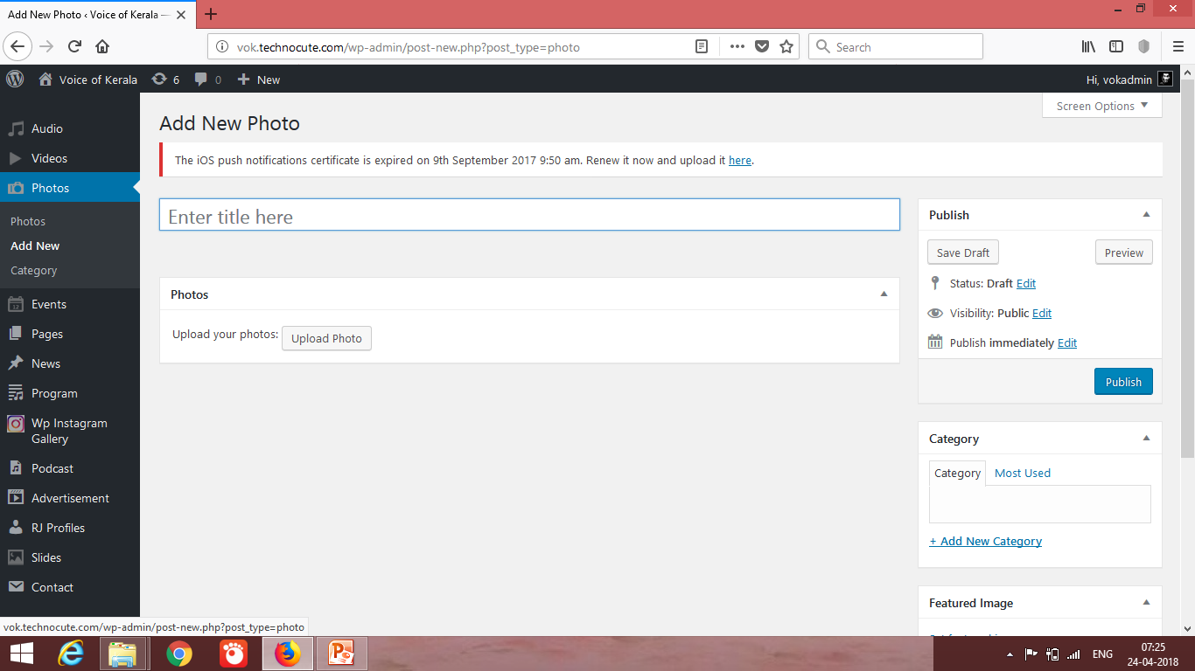
ADD IMAGES

Slide 56
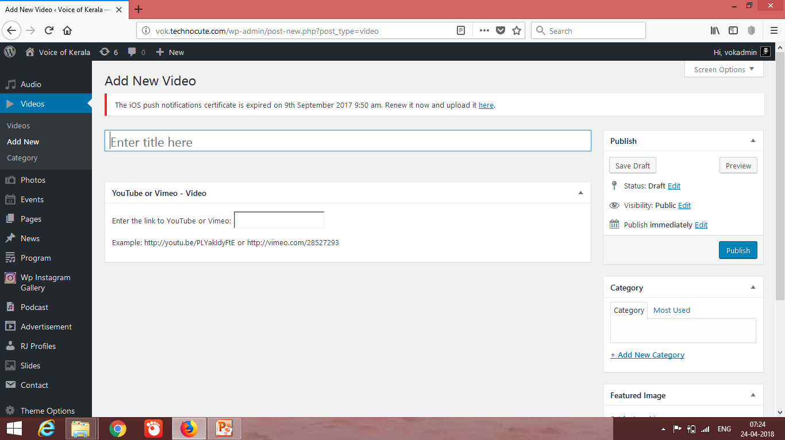
ADD VIDEOS

Slide 57


